Slide 1
HR ANALYTICS PROJECT Employees Survey and Performance Analysis
Presented by ,
Dhanashree Dhadge
Keerthana U
Ruth Lovelyn M
Sowmiya C
Hima

Slide 2
INTRODUCTION
Employee Survey involves collection of various employee's details like ID, age, Location, Job-Role, Work-Life Balance, Location, promotion, Work Experience etc.,
This survey analyze the Employees work details and other information's to get insight of each job nature.

Slide 3
OBJECTIVE
The main objective is to query the given data and produce meaning full insight to understand better about the Work culture and other aspects that influence the job.
ML algorithms is used to explore, analyze, and find meaning in complex data sets. They can perform tasks such as pattern recognition, classification, and prediction. We also used Feature engineering to improve the performance of machine learning algorithms by transforming raw data into relevant inputs
MYSQL is used to analyze the data. Used Constraints, Aggregate functions, DQL (Data Query Language),DML (Data Manipulation Language), string functions, joins.
Power Bi Dashboard to display the visualization of the dataset to summarize the data.

Slide 4


To display the data count in the dataset
Find the total no. of records in the data
The SQL query
SELECT COUNT(*) FROM train;
is used to retrieve the total number of rows in the table.
What is the number of male and female present in the data
The SQL query
SELECT gender, COUNT(Employee_ID) AS Gender_wise_count FROM train
GROUP BY gender;
is used to “aggregate and count” the number of employees based on their gender .

Slide 5
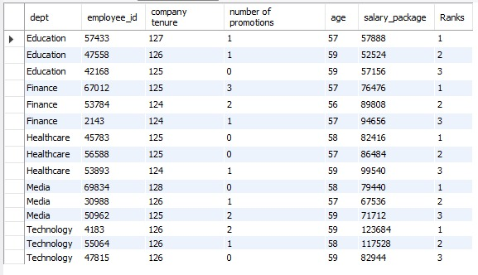
Rank function to display the promotion based on tenure
If the company tenure is same for more than 1 person,
then provide those particular people ranks according to the promotions
This statement is to identify and retrieve the “top 3 employees” in each department of the train(table) based on multiple performance-related factors, such as company tenure, number of promotions, age, and salary package.
This can provide valuable insights into high performers within each department.

Slide 6
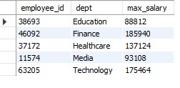
Display second highest salary
Find employee id in each department which has second highest salary
This query is to identify and retrieve the employees with the second-highest salary in each department from the train table.
This can help in analyzing salary distribution and identifying key employees just below the top earners in each department.

Slide 7
Importing necessary dataset and libraries
MACHINE LEARNING
Machine learning is a subset of artificial intelligence (AI) that uses algorithms to analyze data and make predictions.
Importing necessary datasets and libraries in a machine learning project lays the groundwork for effective data analysis, model building, and evaluation. By utilizing the appropriate tools and ensuring the dataset is prepared correctly, you set the stage for successful machine learning outcomes.
In machine learning, various libraries provide essential functions and tools for data manipulation, analysis, model building, and evaluation. Commonly used libraries include:
Numpy
Pandas
Matplotlib
Seaborn
Scikit-learn

Slide 8
Following the naming conventions
Exploratory Data Analysis (EDA) : After importing libraries and loading the dataset, you typically perform exploratory data analysis to understand the dataset better. This includes checking for missing values, data types, and basic statistics.
In EDA process, we also check the datatypes using df.info().
We have to follow the naming conventions in the column names. When naming a module, use lowercase letters and underscores, making it descriptive but concise.
Global variable should be in uppercase with underscores separating words, while local variable should follow the same convention as functions. Demonstrating consistency in naming conventions enhances code readability and maintainability, contributing to a more robust and organized codebase.

Slide 9
Handling Missing Values
df.isna().sum() is used to check for the missing values.
df.duplicated().sum() is used to check for the duplicate datas.
If missing values are available then we have to replace the missing values with mean and median.
Mean is used to replace numerical variables.
Median is used to replace categorical variables.

Slide 10
Handling Outliers
Outliers are those data points which differs significantly from other observations present in given dataset. It can occur because of variability in measurement and due to misinterpretation in filling data points.
sns.boxplot(df.Column name) is used to check for outlier in each columns.
In this method by using Inter Quartile Range(IQR), we detect outliers. IQR tells us the variation in the data set. Any value, which is beyond the range of -1.5 x IQR to 1.5 x IQR treated as outliers.
Q1 represents the 1st quartile/25th percentile of the data.
Q2 represents the 2nd quartile/median/50th percentile of the data.
Q3 represents the 3rd quartile/75th percentile of the data.
(Q1–1.5IQR) represent the smallest value in the data set and (Q3+1.5IQR) represent the largest value in the data set

Slide 11
One Hot Encoding
One-hot encoding is a technique used to convert categorical variables into a format
that can be provided to machine learning algorithms to improve predictions.
We have more categorical data in the dataset so we have used One Hot Encoding.
Here's how it works:
Categorical Data: Suppose you have a categorical variable, like "Color,"
with possible values: Red, Green, and Blue.
Encoding: One-hot encoding converts this categorical variable into a binary format.
Each category becomes a new binary column:
Red: [1, 0, 0]
Green: [0, 1, 0]
Blue: [0, 0, 1]

Slide 12
Correlation Analysis
Correlation analysis is a statistical technique for determining the strength of a link between two variables. It is used to detect patterns and trends in data and to forecast future occurrences.
corr = b.corrwith(b.Performance_status).abs().sort_values(ascending = False)
Cut-off : 0.004
plt.figure(figsize = (20,10))sns.heatmap(b.corr(), annot = True)plt.title("Correlational Analysis of all the variables.")

Slide 13
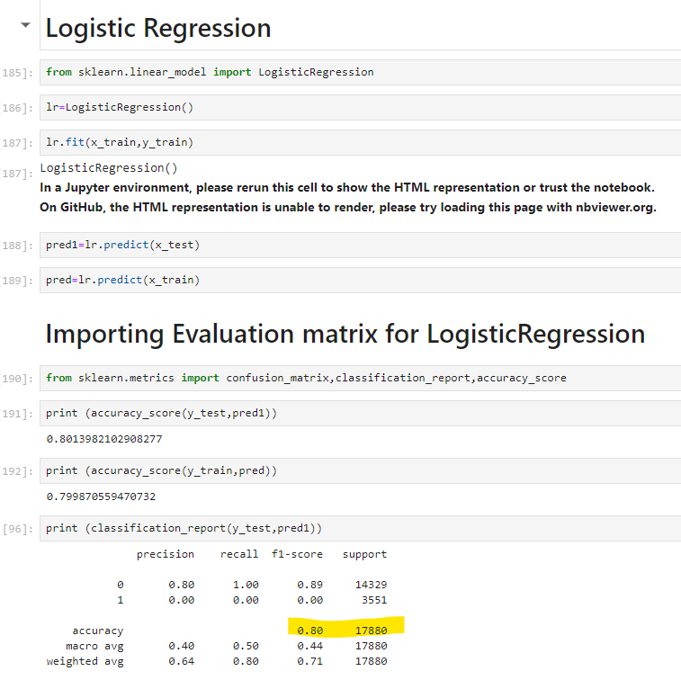
LOGISTIC REGRESSION
Logistic regression is one of the most popular Machine Learning algorithms, which comes under the Supervised Learning technique. It is used for predicting the categorical dependent variable using a given set of independent variables.
It predicts the output of a categorical dependent variable. Therefore the outcome must be a categorical or discrete value.
Training Accuracy : 79%
Testing Accuracy : 80%

Slide 14
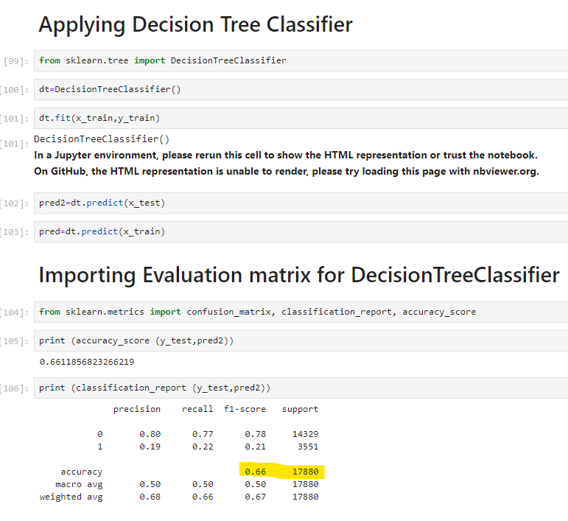
DECISION TREE CLASSIFIER
Decision Tree is a Supervised learning technique that can be used for both classification and Regression problems, but mostly it is preferred for solving Classification problems. It is a tree-structured classifier, where internal nodes represent the features of a dataset, branches represent the decision rules and each leaf node represents the outcome.
In order to build a tree, we use the CART algorithm, which stands for Classification and Regression Tree algorithm.
A decision tree simply asks a question, and based on the answer (Yes/No), it further split the tree into subtrees.
Training Accuracy : 99%
Testing Accuracy : 66%

Slide 15
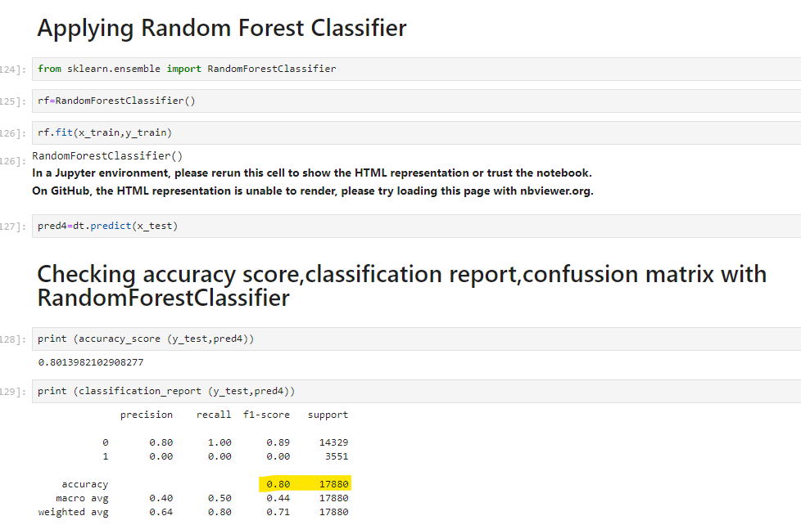
RANDOM FOREST CLASSIFIER
Random Forest is a classifier that contains a number of decision trees on various subsets of the given dataset and takes the average to improve the predictive accuracy of that dataset.
The greater number of trees in the forest leads to higher accuracy and prevents the problem of overfitting.
It can be used for both Classification and Regression problems in ML. It is based on the concept of ensemble learning, which is a process of combining multiple classifiers to solve a complex problem and to improve the performance of the model.
Training Accuracy : 99%
Testing Accuracy : 77%

Slide 16
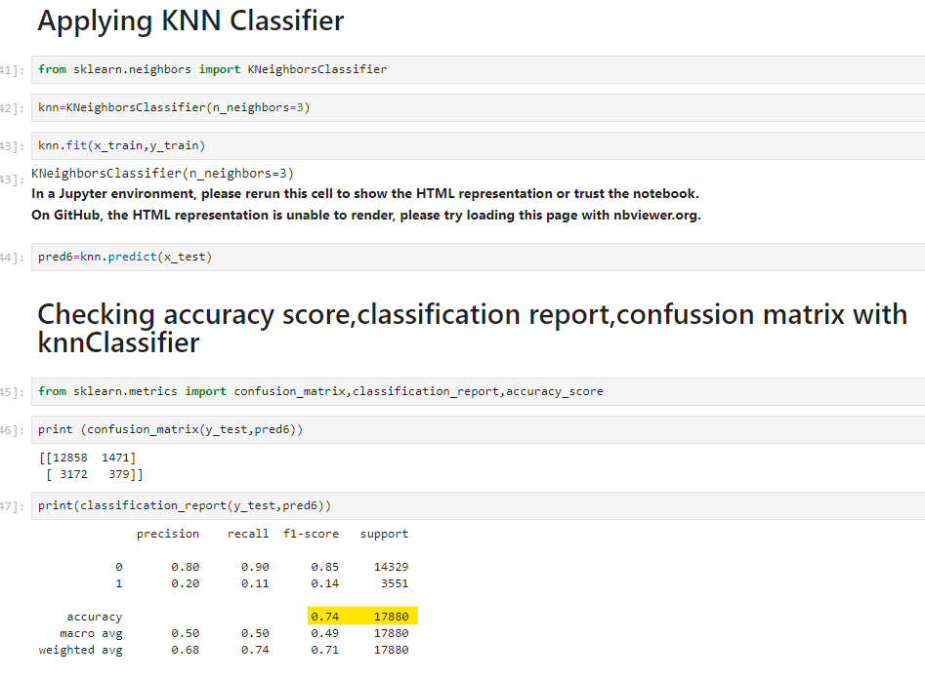
K-NEAREST NEIGHBOUR CLASSIFIER
K-Nearest Neighbour is one of the simplest Machine Learning algorithms based on Supervised Learning technique.
This algorithm assumes the similarity between the new case/data and available cases and put the new case into the category that is most similar to the available categories.
It stores all the available data and classifies a new data point based on the similarity. This means when new data appears then it can be easily classified into a well suite category by using K- NN algorithm.
Training Accuracy : 84%
Testing Accuracy : 74%

Slide 17
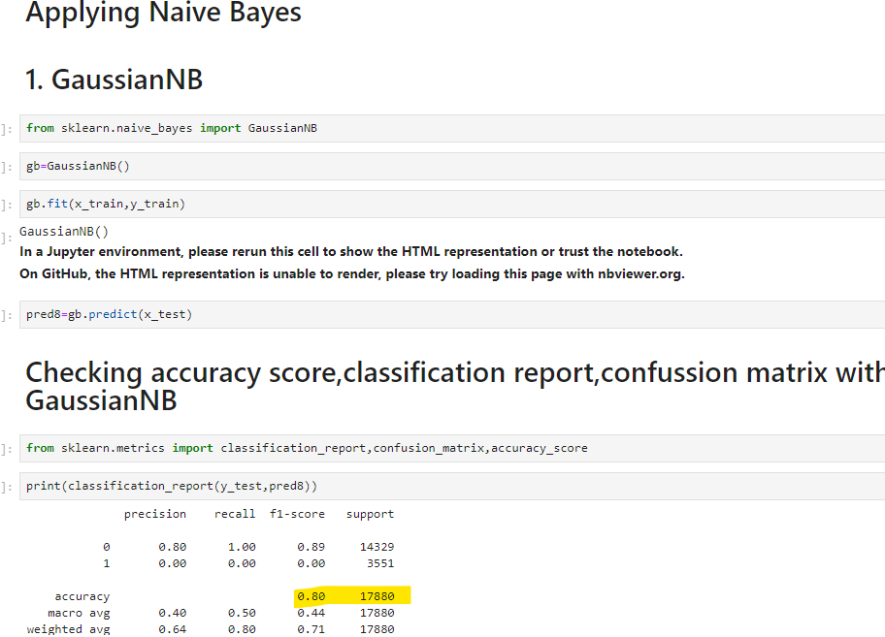
NAIVE BAYES
Naive Bayes algorithm is a supervised learning algorithm, which is based on Bayes theorem and used for solving classification problems.
Gaussian NB :
Training Accuracy : 79%
Testing Accuracy : 80%
Multinomial NB :
Training Accuracy : 79%
Testing Accuracy : 80%
Bernoulli NB :
Training Accuracy : 79%
Testing Accuracy : 80%

Slide 18
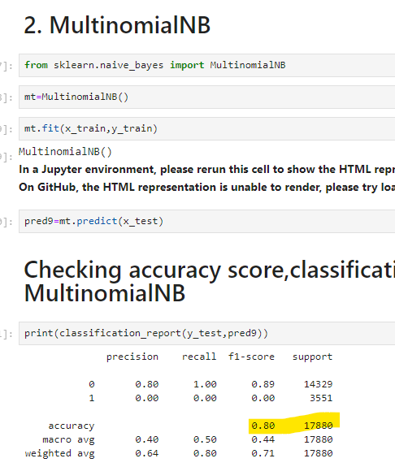
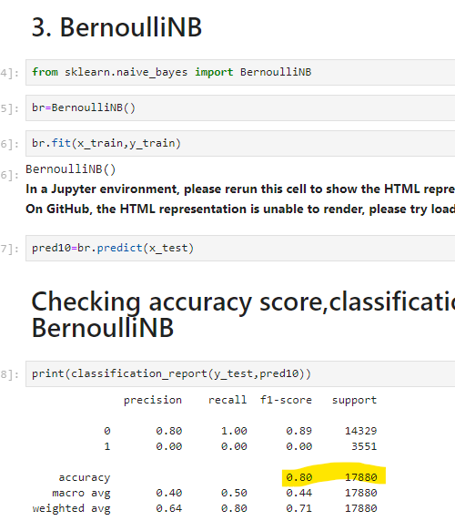
NAIVE BAYES

Slide 19
COMPARING THE ALORITHMS BASED ON ACCURACY
Comparing accuracy in machine learning is a crucial part of model evaluation. While accuracy serves as a valuable baseline metric, it's essential to consider additional performance metrics and the context of the problem to make informed decisions about model selection and deployment.

Slide 20
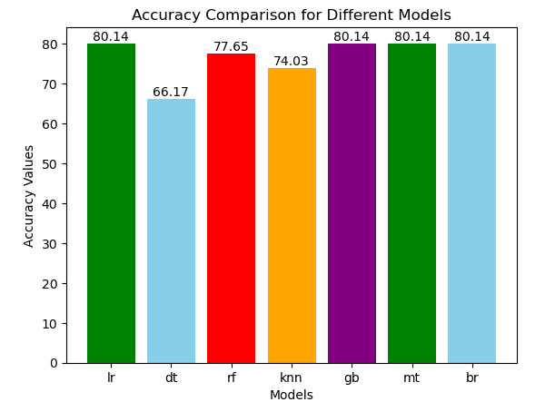
COMPARING THE ALORITHMS BASED ON ACCURACY

Slide 21
CONCLUSION
Logistic Regression and Naive Bayes with accuracy 80% are currently the best-performing models , that the problem may be best solved using these simpler, faster models, especially if the relationships in the data are linear or close to linear, and/or feature independence plays a role.
Random Forest with accuracy 77% may improve with hyperparameter tuning, but given its complexity, it might not offer significant gains over simpler models in this case.
KNN with accuracy 74% and Decision Tree with accuracy 66% are underperforming, with the Decision Tree especially suffering, potentially due to overfitting or the nature of the data. These models are less favorable unless further tuning or preprocessing is applied.

Slide 22
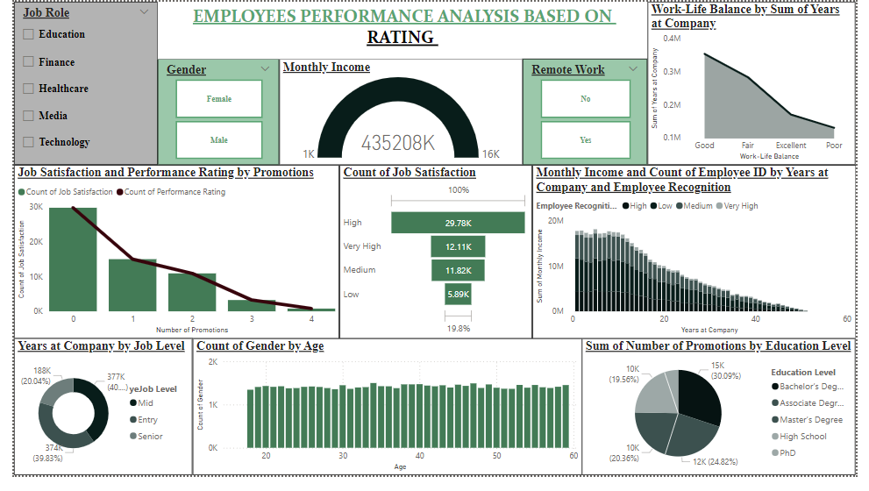
POWER BI DASHBOARD

Slide 23
DASHBOARD - SUMMARIZATION
﻿At 29,716, 0 had the highest Count of Job Satisfaction and was 3,671.07% higher than 4, which had the lowest Count of Job Satisfaction at 788.
Count of Job Satisfaction and total Count of Performance Rating are positively correlated with each other.
﻿Across all 4 Work-Life Balance, Sum of Years at Company ranged from 130473 to 354090.﻿
﻿Good had the highest Sum of Years at Company at 354090, followed by Fair, Excellent, and Poor.
﻿Low had the highest average Sum of Monthly Income at 16,78,824.98, followed by Medium, High, and Very High.
8 in Employee Recognition Low made up 1.67% of Sum of Monthly Income.
Low had the highest total Sum of Monthly Income at 85620074, followed by Medium, High, and Very High.

Slide 24
THANK YOU

